Slide 1
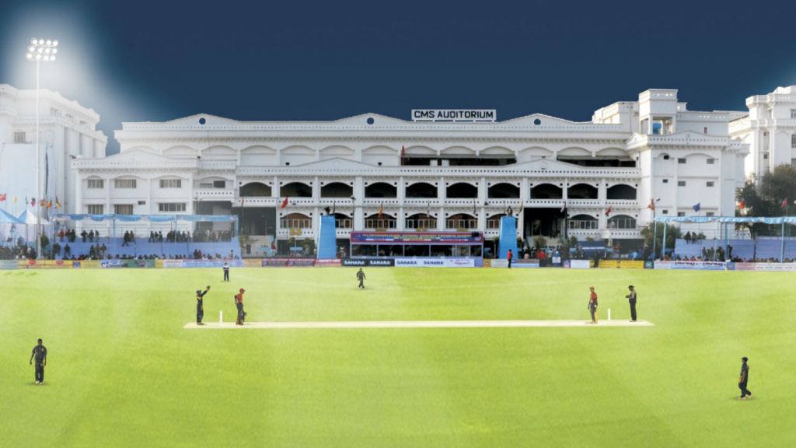
FUN FACT : WORLD’S BIGGEST SCHOOL IS IN INDIA

Slide 2
FUN FACT : WORLD’S BIGGEST SCHOOL IS IN INDIA
Notes:
I prefer to talk instead of writing it down and read.

Slide 3
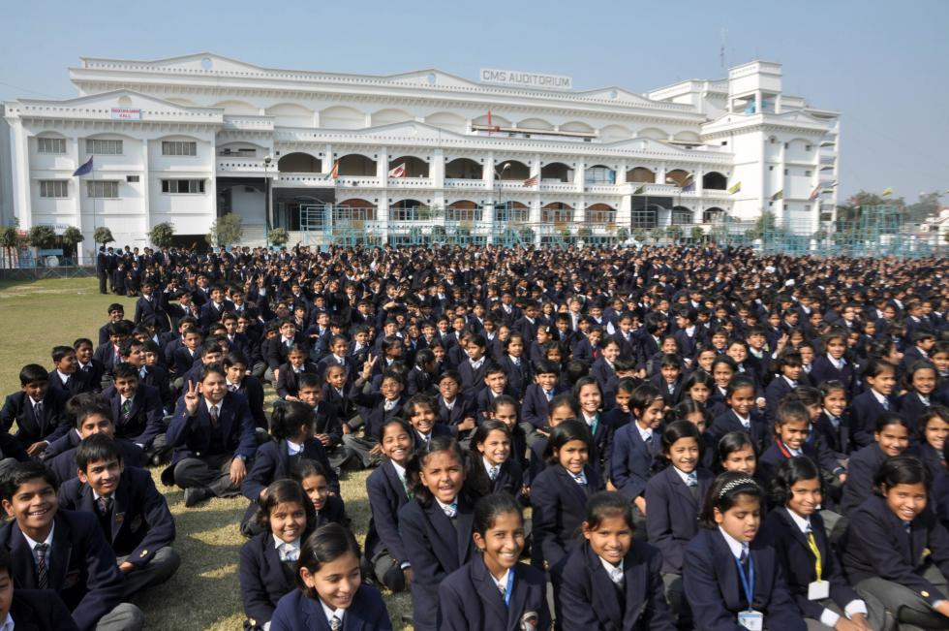
It has 64547 students and more than
1000 classrooms

Slide 4
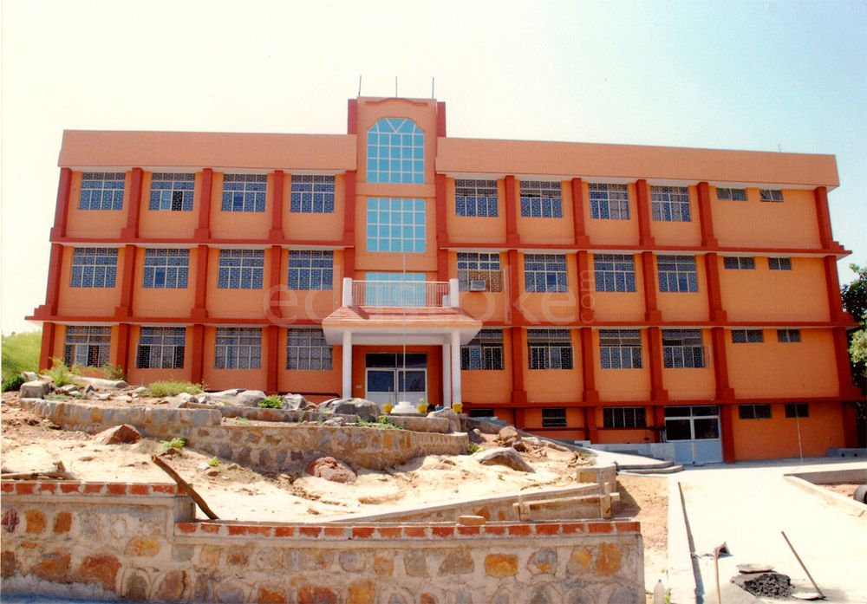
MY SCHOOL

Slide 5
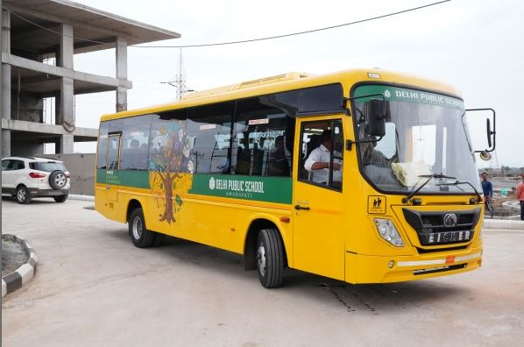
SCHOOL BUS
WHY YELLOW?
Notes:
In India, a lot of kids take school bus to go to school.

Slide 6
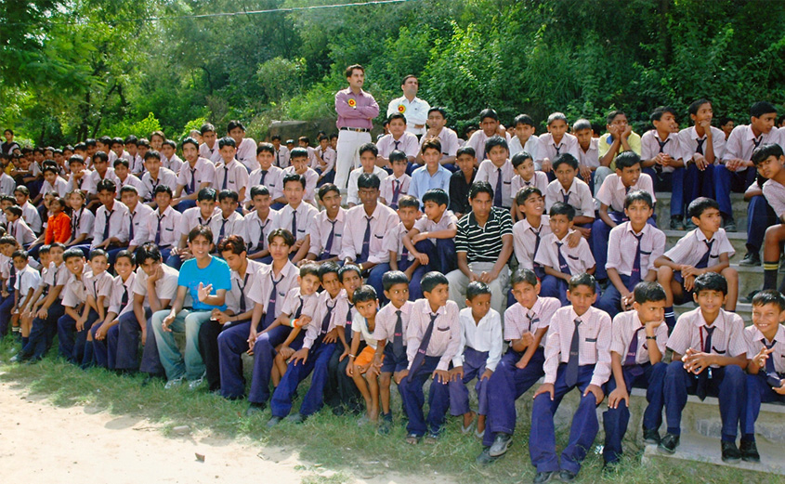
THIS WAS MY SCHOOL’S UNIFORM

Slide 7
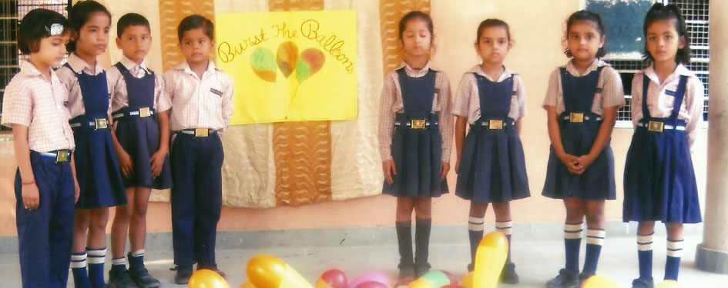
THIS WAS MY SCHOOL’S UNIFORM

Slide 8



School Emblems

Slide 9
School Emblems

Slide 10
School Emblems

Slide 11
School Emblems

Slide 12
School Emblems

Slide 13
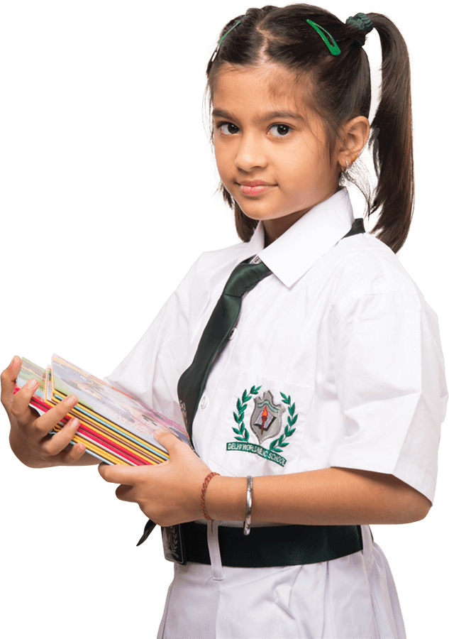



School Emblems

Slide 14
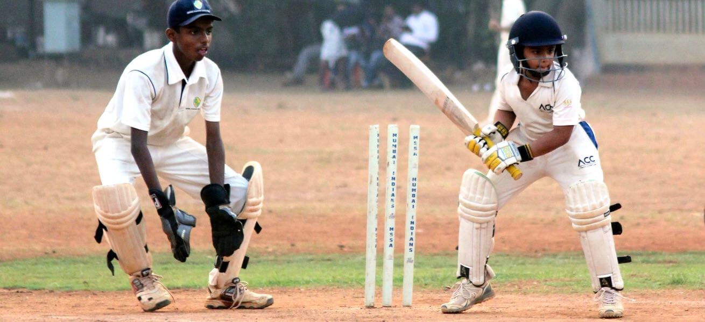
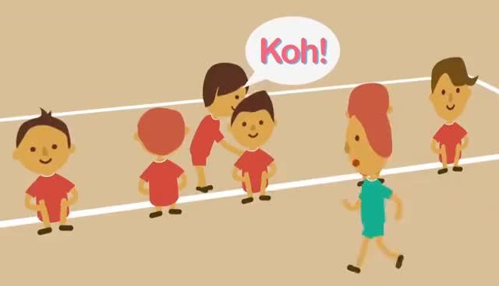
SPORTS IN SCHOOL
Notes:
Cricket and Kho-kho (I play kho-kho with primary kids so I present this in class and cricket with all levels)

Slide 15

THE 5th OF SEPTEMBER,
WE CELEBRATE TEACHER’S DAY
Notes:
Oral presentation

Slide 16
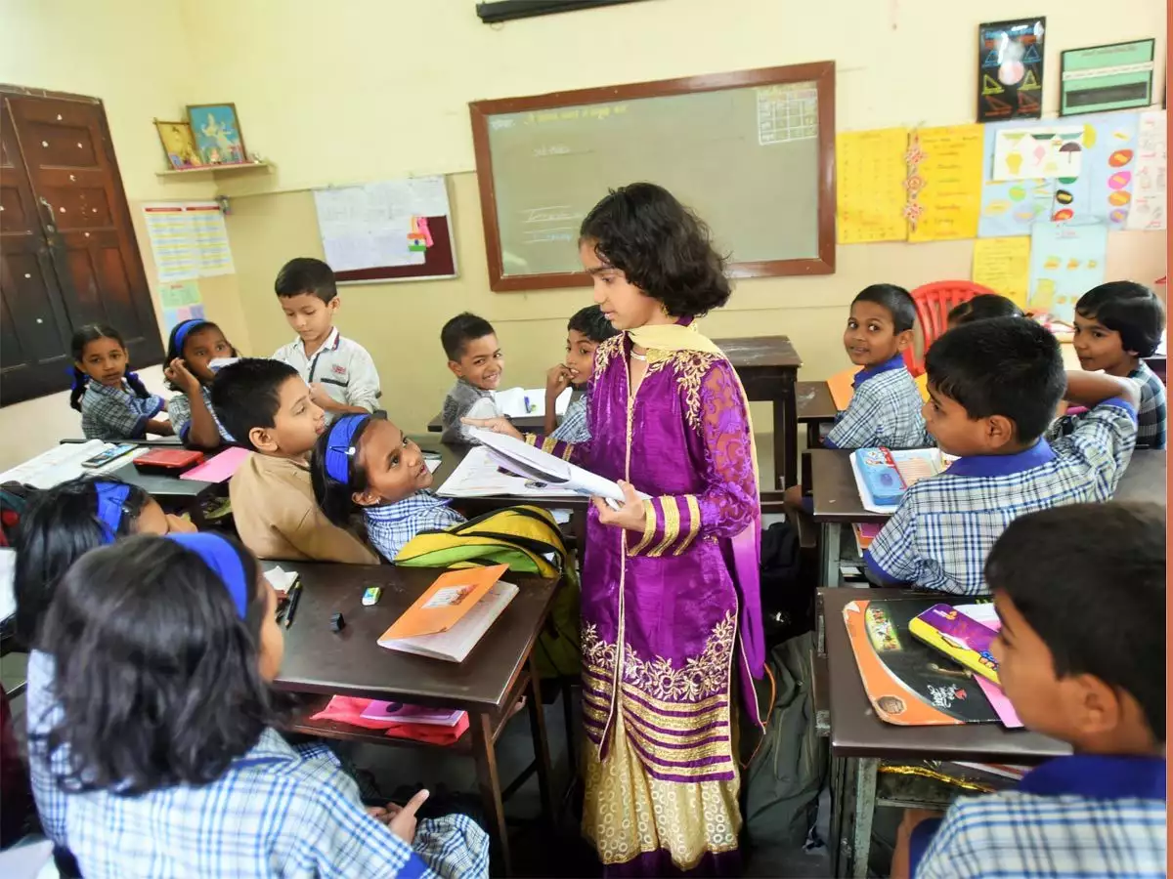
THE 5th OF SEPTEMBER,
WE CELEBRATE TEACHER’S DAY

Slide 17
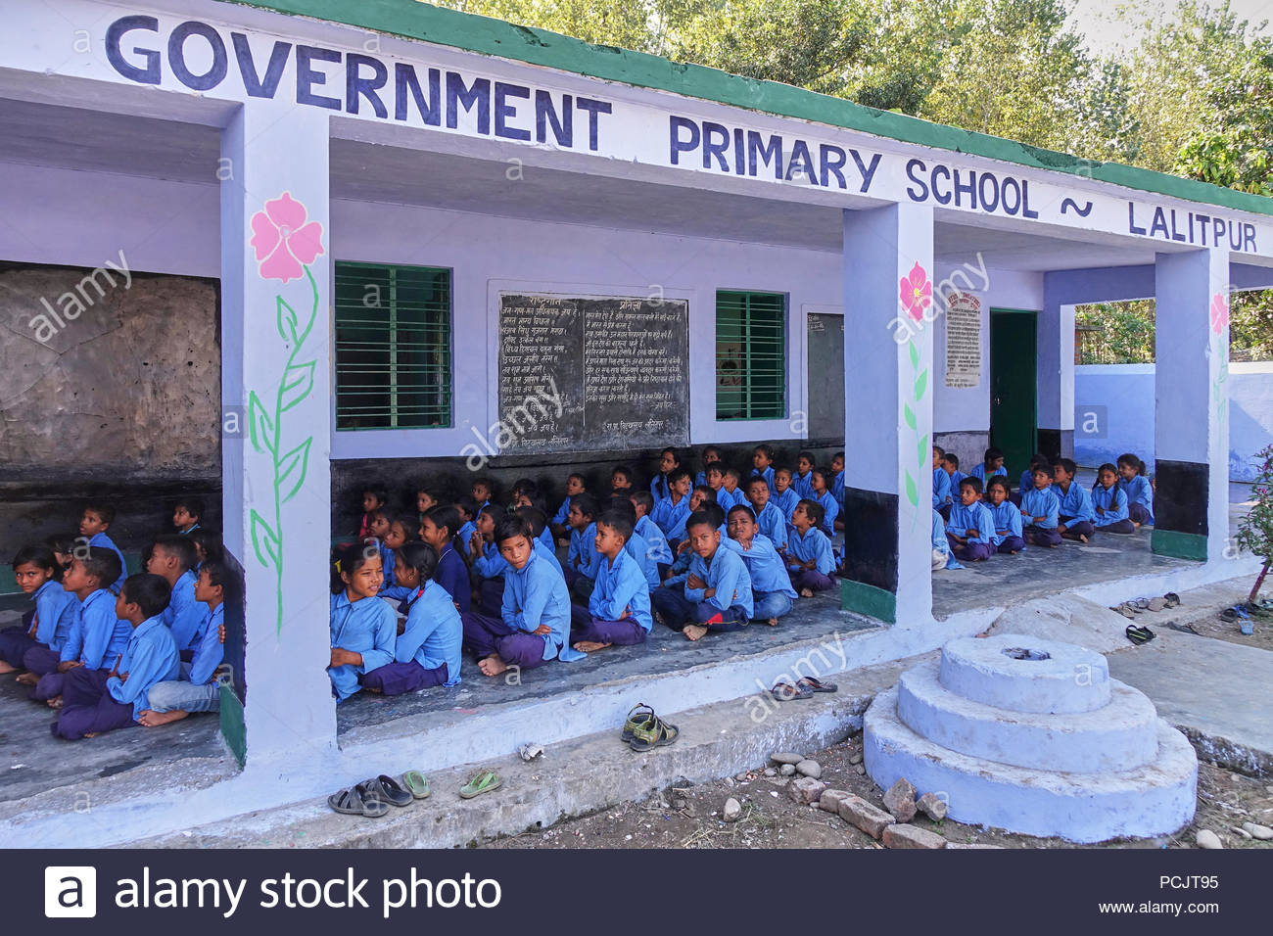
GOVERNMENT FUNDED SCHOOL

Slide 18
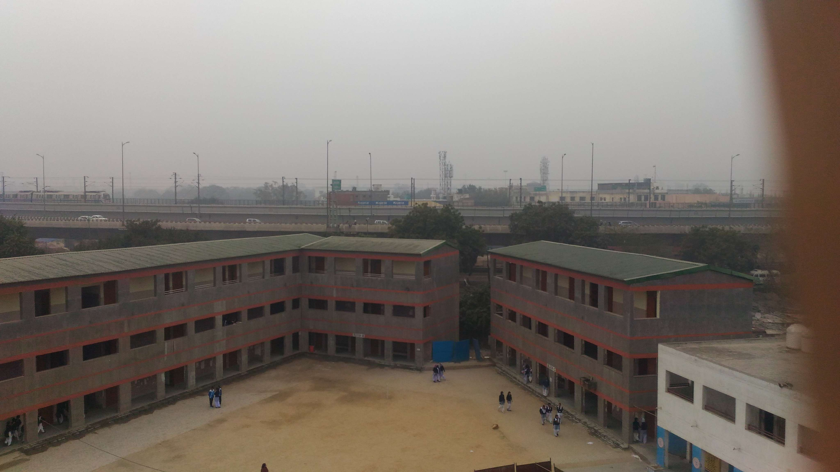
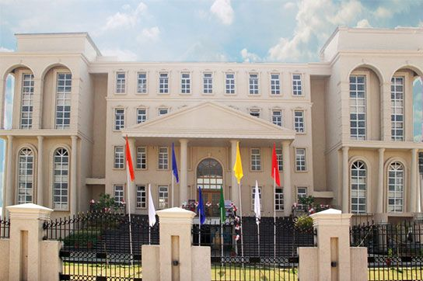
Private school in New Delhi
Public school in New Delhi

Slide 19
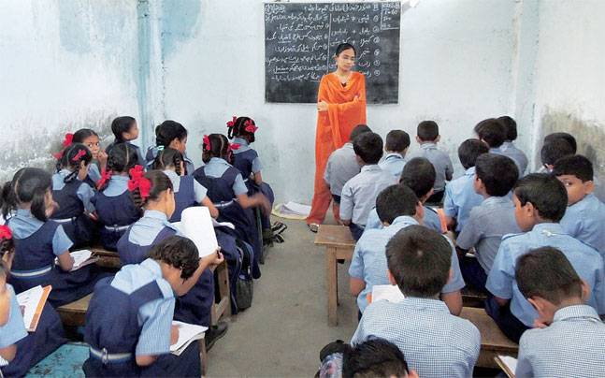
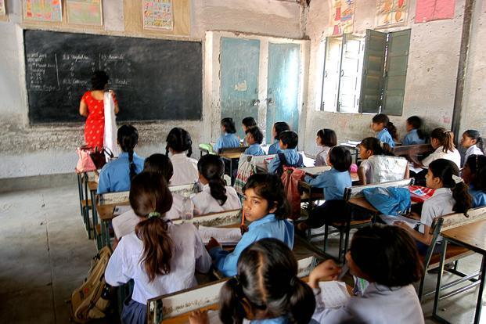
CLASSROOM IN A PUBLIC SCHOOL

Slide 20
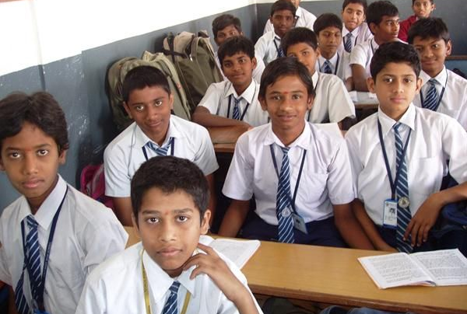
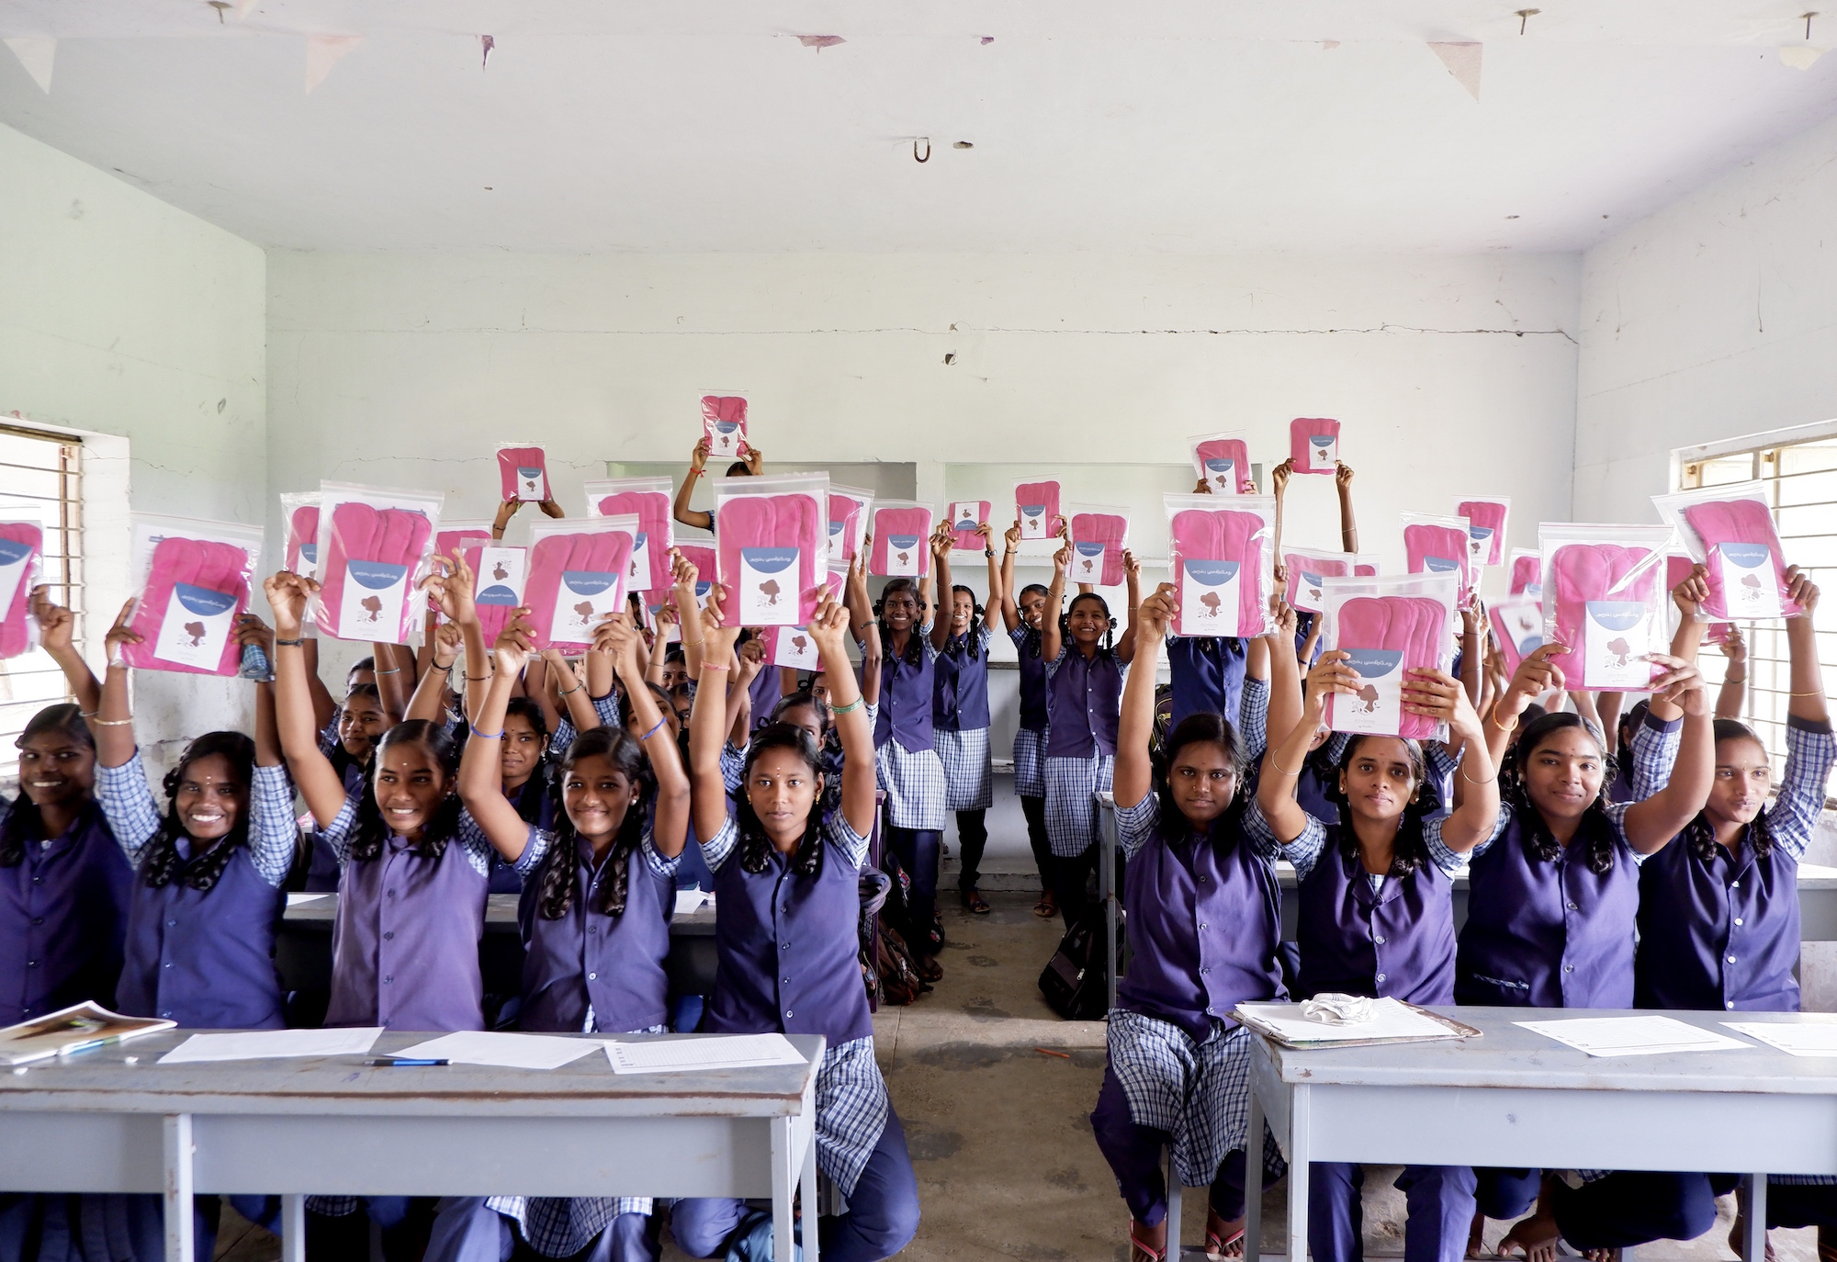
School 1 School 2
In India, there are still separate schools for girls and boys
Notes:
There are many public schools in Delhi where girls attend schools in the morning and boys in the afternoon.

Slide 21
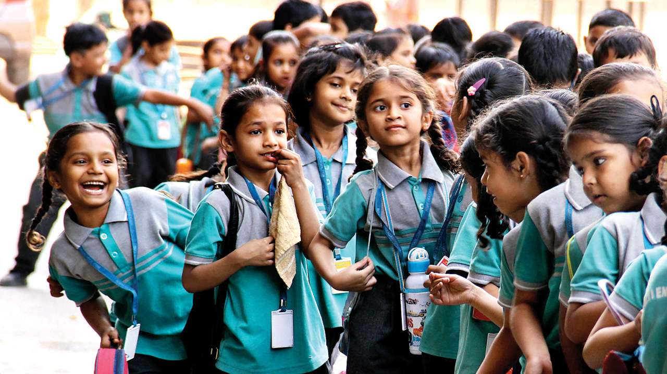
Topic: Girls receive money to attend public schools.
WHY?

Slide 22
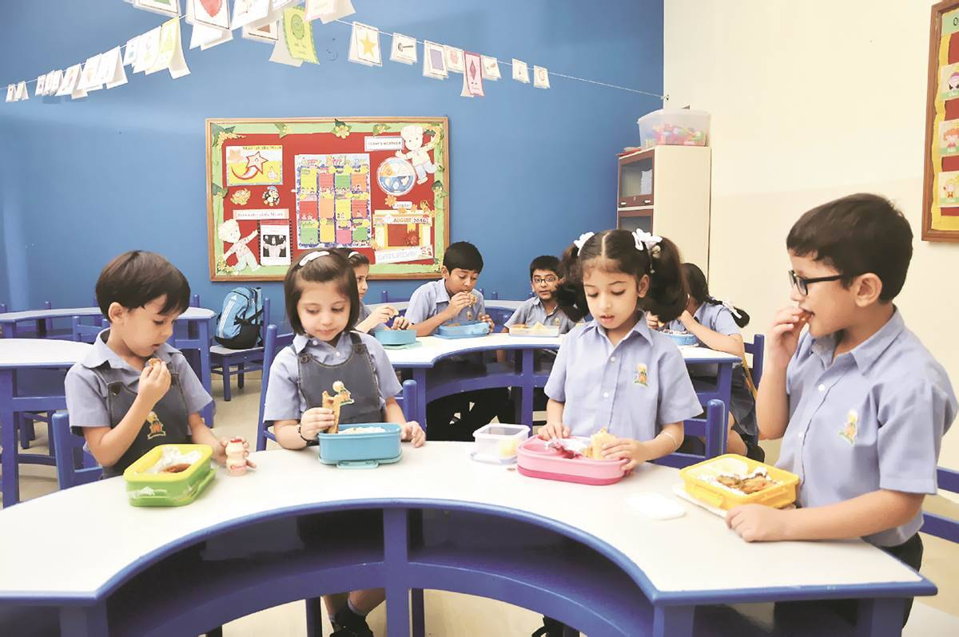
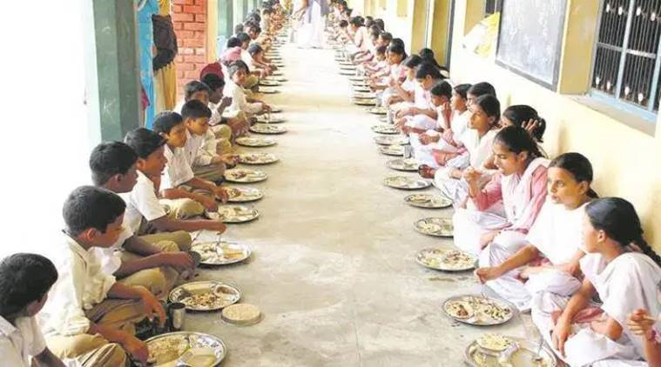
Recess
School 1 School 2
Private Schools are considered better
Students get free food in Public Schools

Slide 23
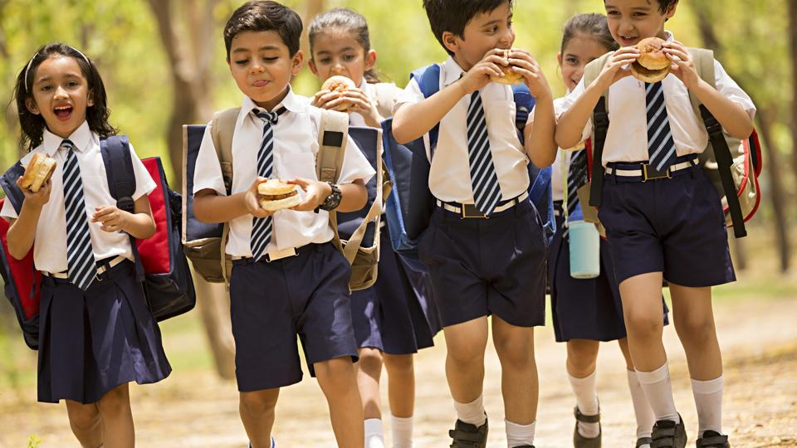
ASK ME MORE QUESTIONS

Slide 24
